Slide 1
Collaborating with Hospitals, ACOs and MCOs
Charles Blankenship CCP, MPO

Slide 2
Hospitals or National Healthcare Systems
ACOs (Accountable Care Organizations) - healthcare organization characterized by a payment and care delivery model that seeks to tie provider reimbursements to quality metrics and reductions in the total cost of care for an assigned population of patients.
MCOs (Managed Care Organizations) - an organization that combines the functions of health insurance, delivery of care, and administration. Also an umbrella term for health plans that provide health care in return for a predetermined monthly fee and coordinate care through a defined network of physicians and hospitals

Slide 3
Charles Blankenship CCP, MPO

Slide 4


Slide 5


Community Paramedics/Mobile Integrated Healthcare
Accountable
Care Organization
Care Coordination Team
Community CaraMedics
Performance Measures
Medical
Records

Slide 6
Our Tools
Care Coordination Team- RN, LCSW, Certified Pharmacy Technician (CPhT). providing ongoing Care Management intervention and community resource linkage as needed
ESO Solutions interface Health Data Exchange (HDE) inserts EMS chart into Cerner EHR
Cerner Chart Access
Access to put visit EHR into Athena Population Health software
Athena Chart Access
Patient Health Questionnaires PHQ-2 and PHQ-9
Medication Assessment and Medication Discrepancy reporting
Home Safety Assessment

Slide 7
Robert Fields North Carolina Medical Journal 2017;78:245-247

Slide 8
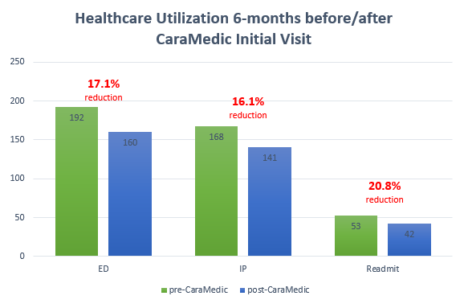
N=92; 115; 27

Slide 9
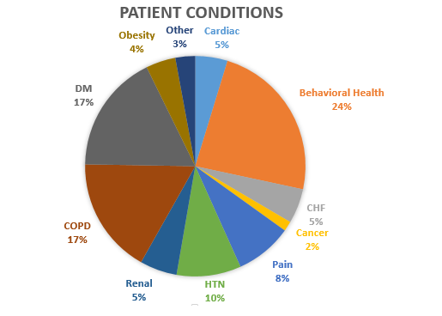

Slide 10
MARA Risk Scores of population:
Range: 1.05 – 69.44
Average: 16.14
PMPM:
Range: $8.20 - $24,809.29
Average: $2,091.93

Slide 11
MARA – Is a risk score system – Milliman Advanced Risk Adjusters. This uses claims data, such as Inpatient, Outpatient, Pharmacy, Physician, Pharmacy, and Emergency Room utilization to capture a “risk” of the patient. The risk score indicates how much riskier the patient is than the national average. So, our pt’s avg. risk score was 16.14, then they are 16.14 times riskier than the average person. They consider a 4 to be pretty high risk.
PMPM – per member per month – this is the average healthcare costs for this patient by month – includes inpatient and outpatient services.

Slide 12
Total Savings $11,236,413
Net Earned Performance Payment
$5,375,365

Slide 13
Terminology of Healthcare Executives
TLAs
FLAs
Buzz Words
Industry trends

Slide 14

“Triple Aim”: improving the individual experience of care; improving the health of populations; and reducing the per capita costs of care for populations.
Donald Berwick
doi: 10.1377/hlthaff.27.3.759 Health Aff May 2008 vol. 27 no. 3 759-769

Slide 15

Our Values
As the regional leader in advanced medical care, we take our responsibilities seriously. Our mission, vision and core values help guide us as we work to help and heal each patient in our care.
Our BIG(GER) Aim:
To get every person to their desired outcome, first without harm, also without waste and always with an exceptional experience for each person, family and team member.
2020 Vision
A regional diversified health system providing superior care and services to patients and their families through a full continuum of integrated services, education and research.

Slide 16
IHI’s focus on Triple Aim for populations includes:
New models of population health management;
Change packages to support the Triple Aim, starting with high-risk, high-cost populations;
Large campaigns and other population health initiatives to improve population outcomes at scale, with a particular focus on reducing disparities or inequities;
Extending reach and impact by building capacity and skills for population health improvement; and
Providing assessment, design, and capability for comprehensive quality strategies for nations and other large health systems.
http://www.ihi.org/Topics/TripleAim/Pages/Overview.aspx

Slide 17
Healthcare organizations must move faster to retooling.
Providing systems and processes to meet future demands.
Big Data is a necessary evil to solve many healthcare challenges.
Need for integrated systems and a major shift in focus to patient outcomes.
A management-led model of healthcare.

Slide 18
Seamless electronic medical records.
standard treatment protocols and care process models.
Embracing metrics to measure clinical performance, such as patient satisfaction, quality and cost.
Accreditations, Commissions, Certifications and Verifications.

Slide 19
Y-CHNA
YOUR - Community/Local Hospital Needs Assessment
Not National, Province, State, Region or County
Department Level Focus
Forget Bias
Focus on doing the greatest good for the greatest needs

Slide 20
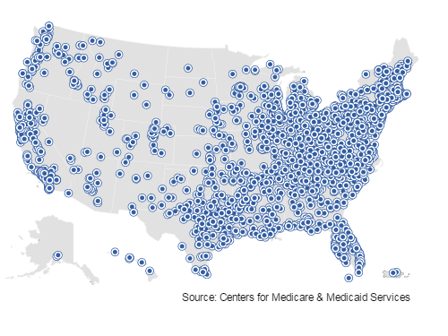
Comprehensive Care for Joint Replacement Model

Slide 21

The Bundled Payments for Care Improvement (BPCI) initiative is comprised of four broadly defined models of care
In Model 2, the episode includes the inpatient stay in an acute care hospital plus the post-acute care and all related services up to 90 days after hospital discharge.
48 clinical episodes
Diagnosis Related Groups (DRGs) range from AMI to UTI

Slide 22
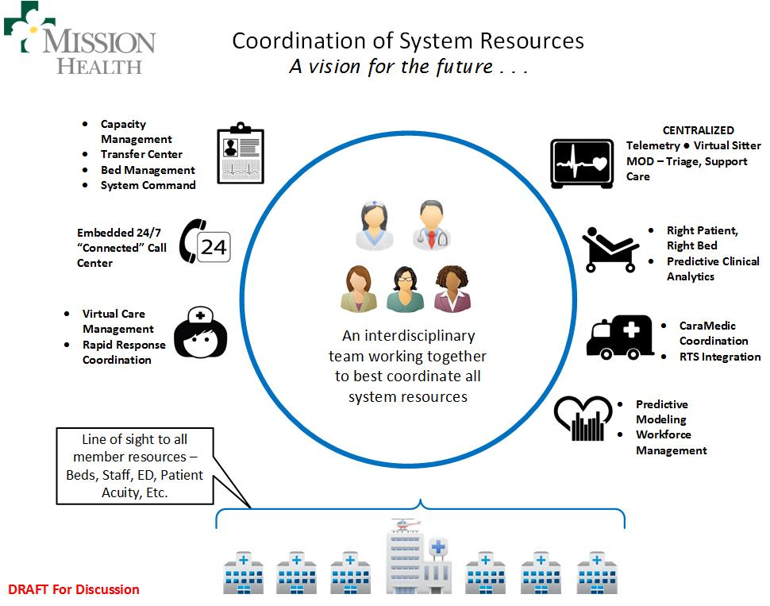
Mission Care Coordination Center

Slide 23
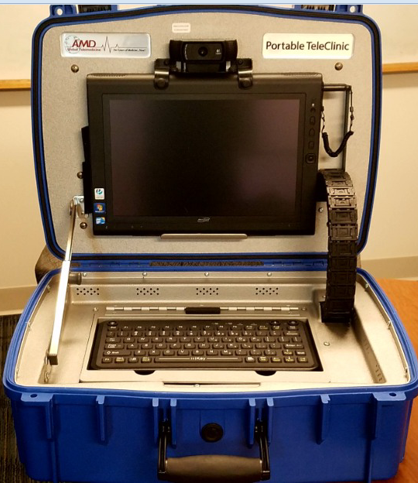
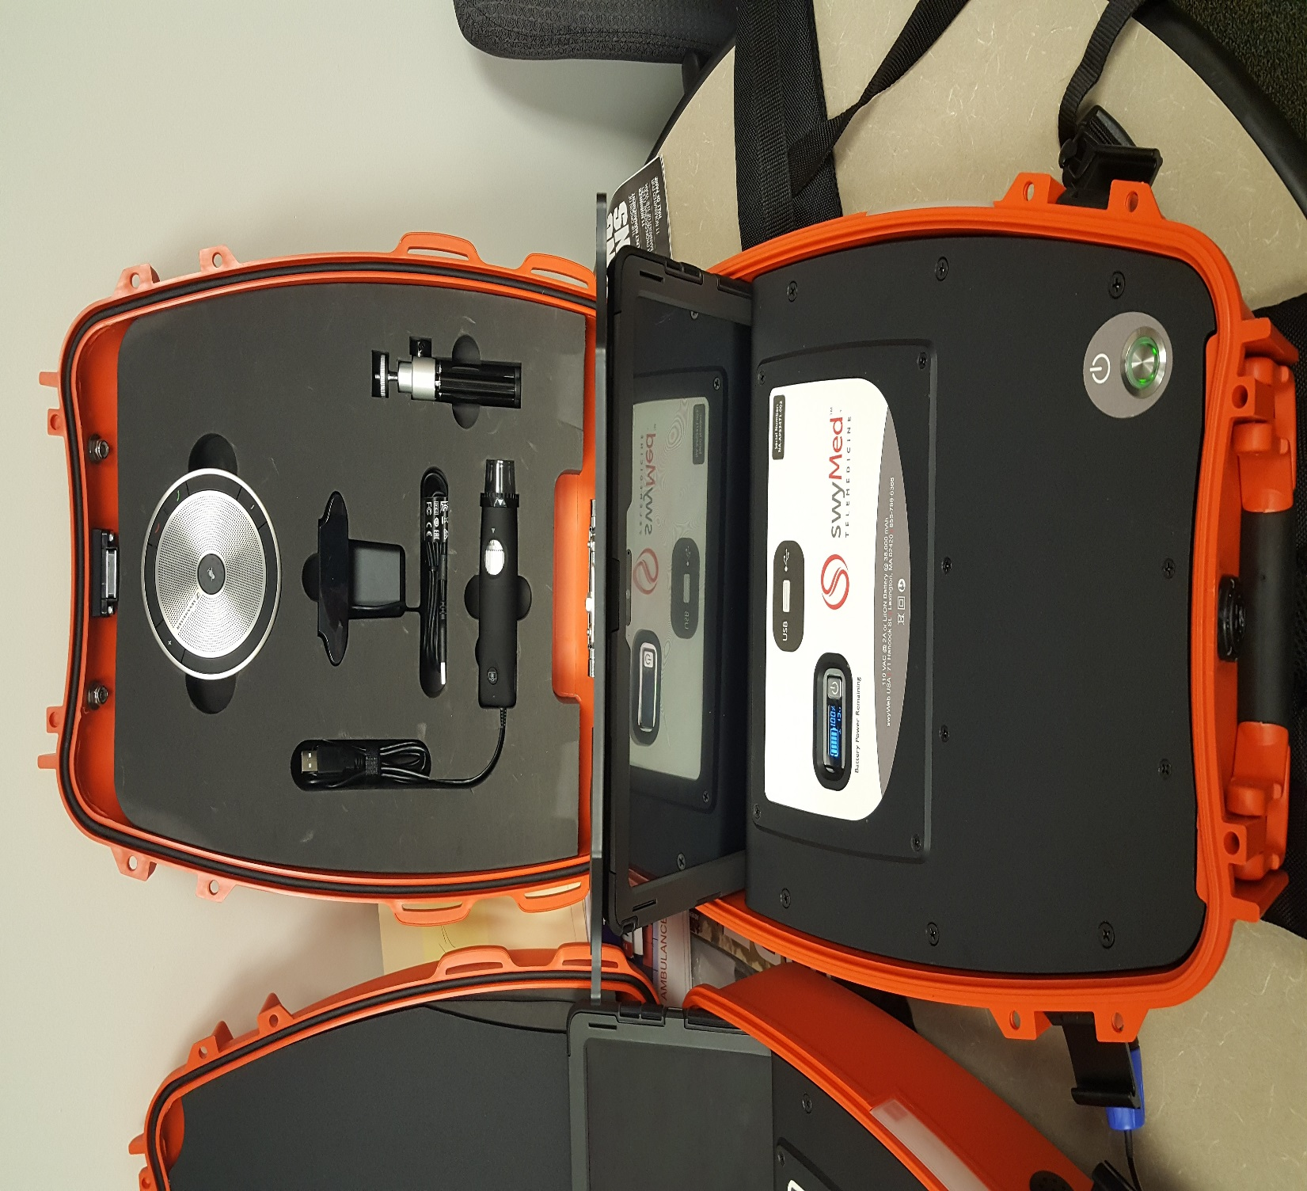

Slide 24
Is There Unique Value of Telehealth/Remote Home Monitoring for CP/MIH?
Missed Appointments; Early Discharges
H@H Plus Alternative Payment Model (APM)
Medication reconciliation, logs and reminders
Video visits: on-demand and scheduled
Patient education videos and other material
Daily Questionnaire completion and wellness check-ins

Slide 25
Population Health Coverage
Levels of Community Paramedic
Community Responders
Public Health Awareness Participants

Slide 26

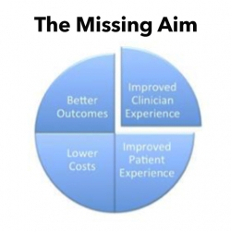

Slide 27
Charles A. Blankenship; CCP, BS, MPO
cedcab@msj.org
Mission Health System
509 Biltmore Ave., Asheville, NC 28801
Office (828)213-9040
“The idea is that if you have a big dream, then you have to fall in love with doing things that others won't, to accomplish what others can't!” Brett Hagler

